Slide 1

Group Member
- Hira Anzar

Slide 2

List of Content
Introduction
Data cleaning
Required Tables
Cards
Graphs
Page 1
Page 2
Page 3

Slide 3
Introduction
Blinkit (formerly Grofers) is India's leading quick-commerce platform, delivering groceries, essentials, electronics, and more in minutes (often under 10) through a network of "dark stores," revolutionizing online shopping with speed and convenience for urban consumers. Acquired by Zomato, Blinkit leverages technology and a dense logistics network to offer ultra-fast delivery, expanding beyond groceries to beauty, electronics, and books, driven by a mission to make instant commerce "indistinguishable from magic“.

Slide 4



Data Cleaning
For data cleaning SQL was used
Distinct

Slide 5
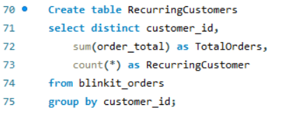
Required Tables
In the project, there were few tables that were required:
Recurring customers
Total quantity per products
Inventory

Slide 6
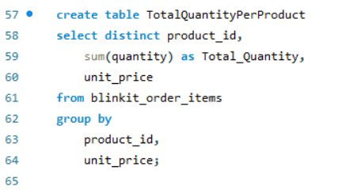
Required Tables
In the project, there were few tables that were required:
Recurring customers
Total quantity per products
Inventory

Slide 7
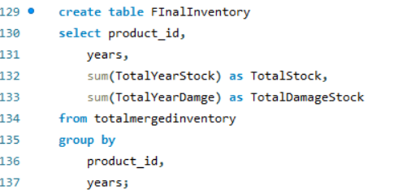
Required Tables
In the project, there were few tables that were required:
Recurring customers
Total quantity per products
Inventory

Slide 8
Cards
Power BI cards are versatile visuals for displaying single key metrics (like total sales) or summary numbers (like counts) as prominent, easily digestible snapshots
Customer Feedback Analysis
Avg Rating
Customer Lifetime value
Marketing and delivery Performance
Total Customers
Churn Rate
On-Time Delivery
CTR %
Avg Time Delivery
Conversion Rate
Inventory Analysis
Stores
Damage Rate %
Current Stock
Avg Shelf Life

Slide 9
Graphs
Power BI uses various "visuals" (graphs/charts) like bar, line, pie, scatter, maps, and custom visuals to transform data into insights, created by dragging fields onto axes/values in the Visualizations pane
Customer Feedback Analysis
Marketing and delivery Performance
Inventory Analysis
Delivery Status By Orders
FeedBack By Rating
Customer By Sentiments
Orders by Areas
Feedback and Rating by Month and Year
Orders by Satisfaction
Revenue Generated vs Total Spending by Channel
On-time Vs Late delivery
Conversion By Targetted Audience
ROAS By Campaign Name
Delay Vs Distance
Total Order by Payment Method
Received and Damage Stock
Total Orders by Store ID
Unit price and quantity by Product Name

Slide 10
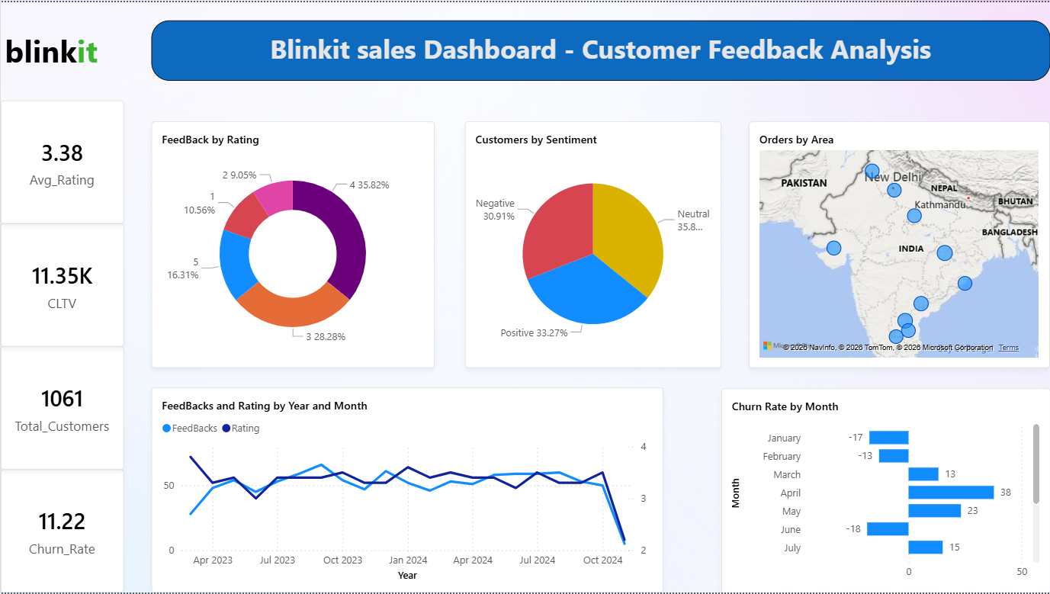
Page 1

Slide 11
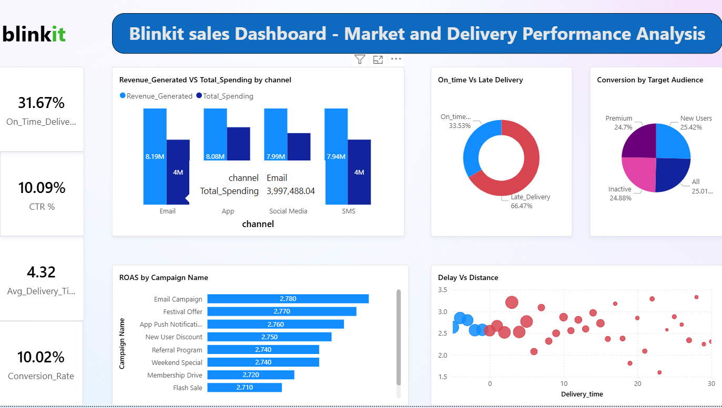
Page 2

Slide 12
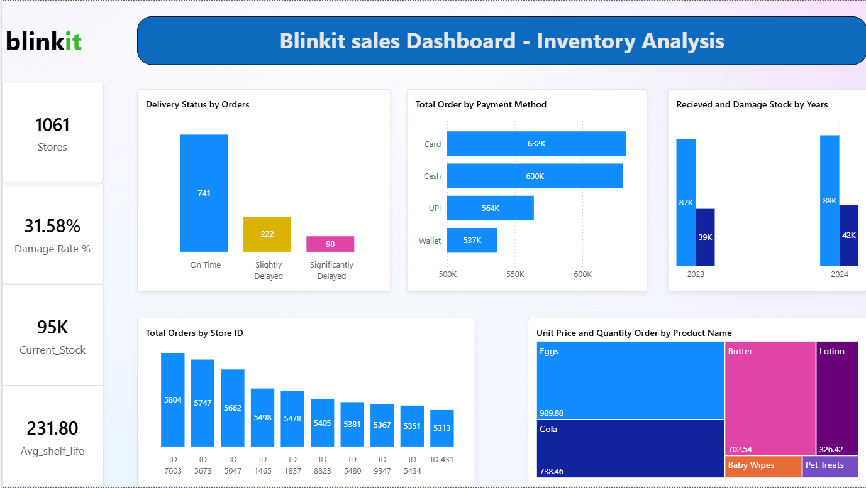
Page 3

Slide 13
The End

